Slide 1
Tutor Assignment Optimization Framework
HTX xData technical assessment
Vijayakumar Sabarina
2 March 2026

Slide 2
Contents
Problem Statement
Data Preprocessing
Optimization Approach
Model Formulation
Objective Function (a)
Objective Function (b)
Results
Combining Objectives
Conclusion

Slide 3
1. Problem Statement
Objective: Develop a flexible optimization model to support allocation of students to tutors under varying business priorities
Considerations:
1 student → 1 tutor
Skill compatibility
Capacity limits of tutors
Tutors’ centre preferences

Slide 4
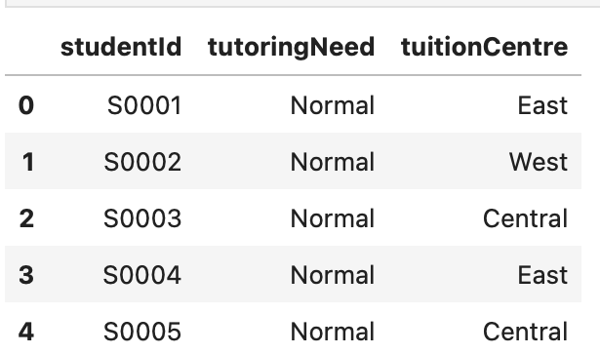
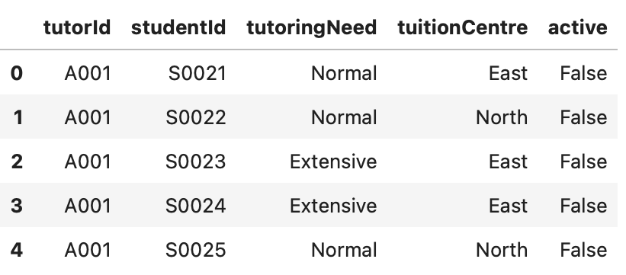
2. Data Preprocessing
New students
Existing students

Slide 5
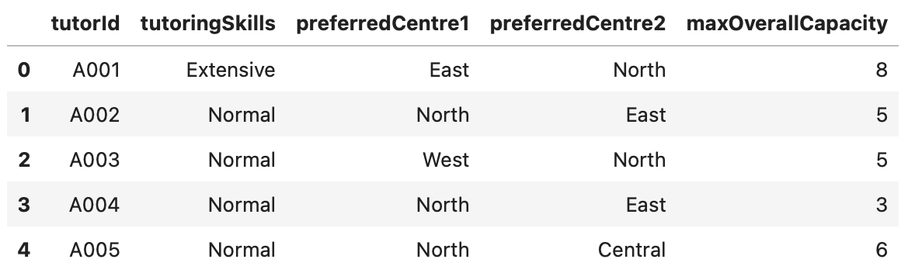
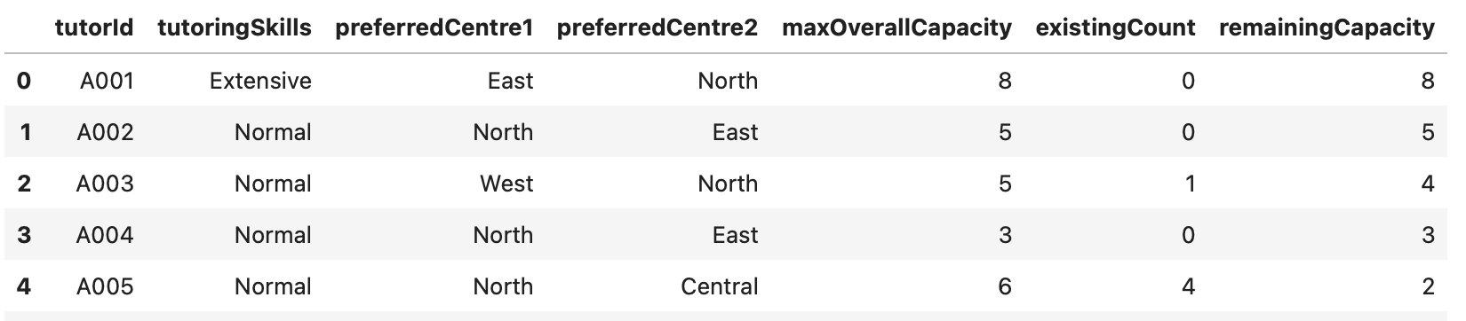
2. Data Preprocessing
Tutors

Slide 6
3. Optimization Approach
Mixed-Integer Programming (MIP) implemented using Python + DOcplex
Binary decision variables
Hard constraints + considerations
Weighted objective functions

Slide 7
3. Optimization Approach
Minimize tutors used (scenario (a))
Balance workload/ minimize spread (scenario (b))
Maximize tutors’ centre preference score
Constraints → Objective → Solver → Results
No. of tutors used
Workload range
Workload spread
Preference satisfaction rate
1 student → 1 tutor
Cannot exceed tutor’s max capacity
Students requiring extensive teaching → tutor with extensive skill
Implemented using DOcplex

Slide 8


4. Model Formulation
Binary Decision Variable
$$x_{s,t}=\left\{\begin{aligned}&1, student s is assigned to tutor t \\ &0, otherwise\end{aligned}\right.$$
Sum to be minimized
Tutor Assignment Variable
$$y_{t}=\left\{\begin{aligned}&1, if tutor t is assigned at least 1 student \\ &0, otherwise\end{aligned}\right.$$

Slide 9


4. Model Formulation
Standard deviation to be minimized
Workload Spread Variable
$${after}_{t}= {existingCount}_{t} + \sum_{s}{x_{s,t}}$$
Constraint 1: 1 student → 1 tutor
$$\sum_{t}{x_{s,t} = 1 ∀ s}$$

Slide 10



4. Model Formulation
Constraint 2: Skill level
$$x_{s,t}=\left\{\begin{aligned}&1, if student s requires extensive skill and tutor t has extensive skill \\ &0, otherwise\end{aligned}\right.$$
$$\sum_{t}{x_{s,t} = 1 ∀ s}$$
Constraint 3: Tutor capacity
$$\sum_{s}{x_{s,t}} ≤ {remainingCapacity}_{t}$$

Slide 11

4. Model Formulation
Preference Score
Sum to be maximized
$${PrefScore}_{s,t}=\left\{\begin{aligned}2, 1st choice centre \\ 1, 2nd choice centre \\ 0, otherwise \end{aligned}\right.$$

Slide 12
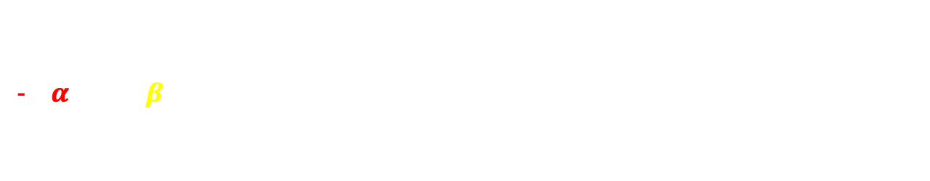

5. Objective Function (a)
$$Min α\sum_{t}{y_{t}} − β\sum_{s,t}{{PrefScore}_{s,t}x_{s,t}}$$
Minimizing sum of tutors assigned
Maximizing preference score
$α$= 70, $β$= 1 → minimizing sum of tutors is 70 times more important than tuition centre preference

Slide 13
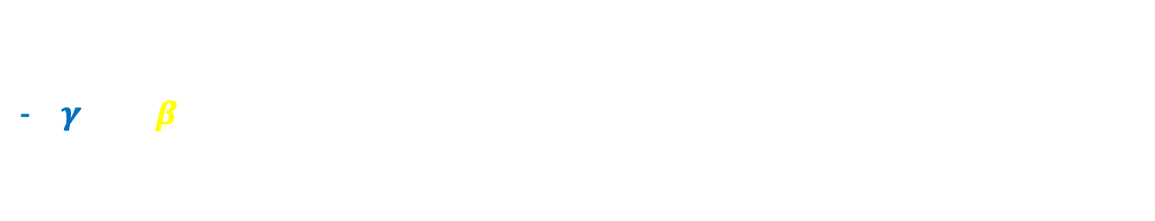

6. Objective Function (b)
$$Min γ{\left({after}_{t}\right)}^{2}− β\sum_{s,t}{{PrefScore}_{s,t}x_{s,t}}$$
Minimizing spread → minimizing deviation from the mean
Maximizing preference score
$γ$= 2, $β$= 1 → minimizing spread is much more important than tuition centre preference since quadratic terms grow much faster

Slide 14

7. Results
Key Metric | (a) Minimize tutors | (b) Balance workload
No. of tutors | 5 | 10
Range of workload | 0 – 8 students | 2 – 5 students
Workload std deviation | 3.3 students | 0.75 students
Preference Satisfaction Rate | 90% | 100%
$\frac{Number of assignments to 1st /2nd choice locations}{Total number of tutor assignments}$ x 100

Slide 15
7. Results
Key Metric | (a): Minimize tutors | (b) Balance workload
No. of tutors | 5 | 10
Range of workload | 0 – 8 students | 2 – 5 students
Workload spread | 3.3 students | 0.75 students
Preference Satisfaction Rate | 90% | 100%

Slide 16
8. (a) + (b) = (c) ?

Slide 17
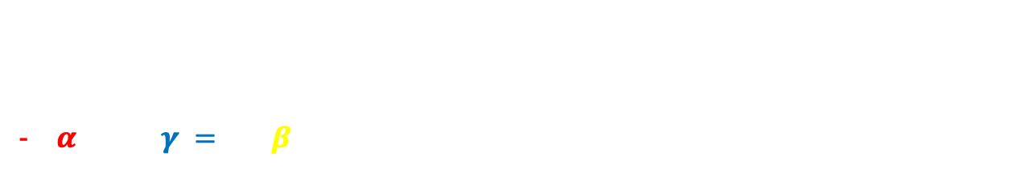
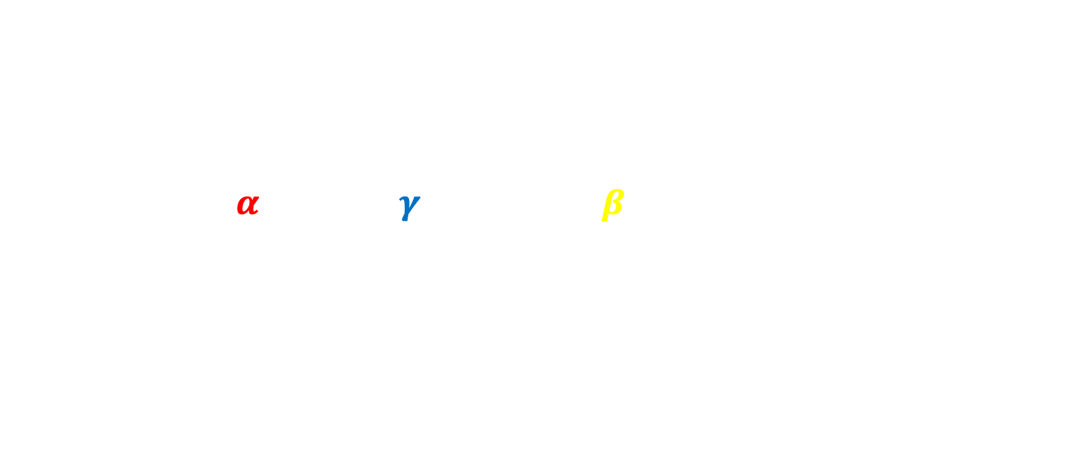
8. Objective Function (c)
$$Min α\sum_{t}{y_{t}} +γ{\left({after}_{t}\right)}^{2}− β\sum_{s,t}{{PrefScore}_{s,t}x_{s,t}}$$
Minimizing sum of tutors assigned
Minimizing spread → minimizing deviation from the mean
Maximizing preference score
$α$= 50, $γ = 2,$ $β$= 1

Slide 18
9. Conclusion
Key Metric | (a): Minimize tutors | (b) Balance workload | (c) Combined objectives
No. of tutors | 5 | 10 | 7
Range of workload | 0 – 8 students | 2 – 5 students | 0 – 5 students
Workload spread | 3.3 students | 0.75 students | 2.14 students
Preference Satisfaction Rate | 90% | 100% | 100%

Slide 19
9. Conclusion
3 strategic scenarios were evaluated:
Scenario (a) prioritized operation efficiency by minimizing the number of tutors used
Scenario (b) prioritized fairness by minimizing workload spread among tutors
Scenario (c) combined both objectives to produce a balanced, compromised solution
Overall, the model provides a flexible, scalable decision support tool that can be adapted to evolving operational priorities while maintaining transparency and consistency in assignment decisions

Slide 20
Thank you! Any questions?

